Slide 1
Yale Climate Opinion Maps
2021

Slide 2
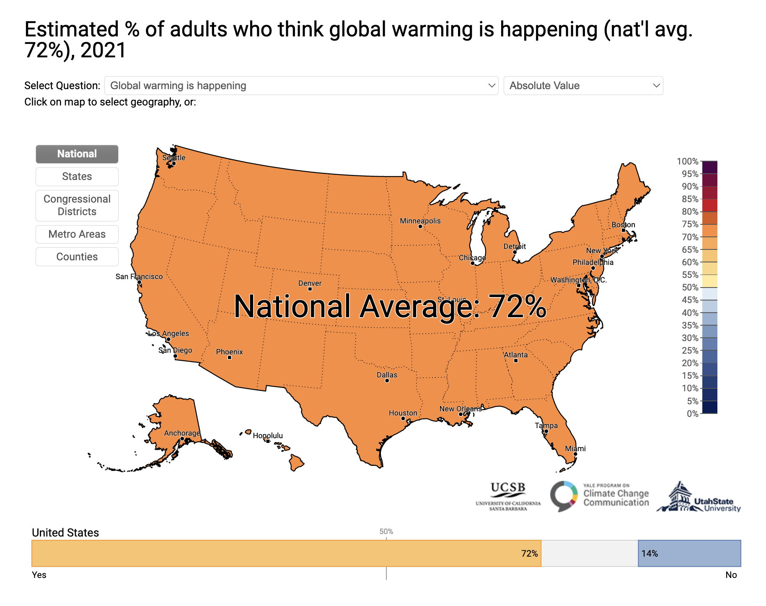
% of adults who think global warming is happening

Slide 3
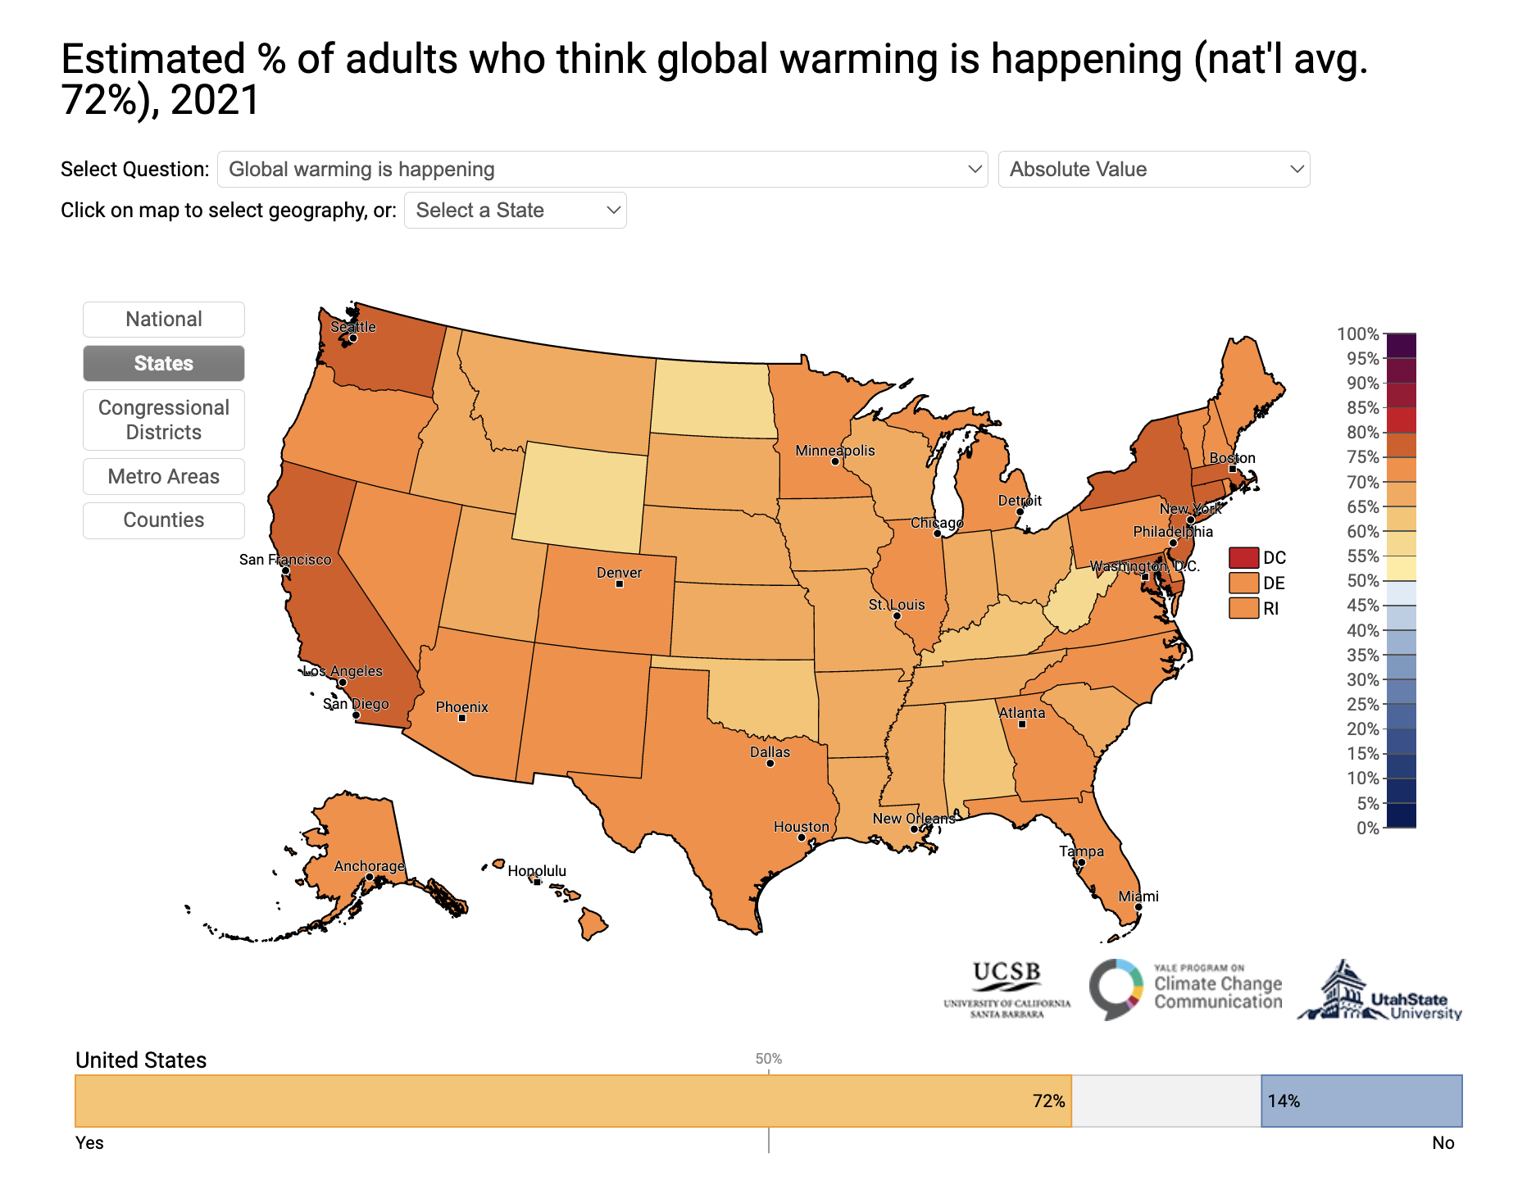
% who think global warming is happening (72%)

Slide 4
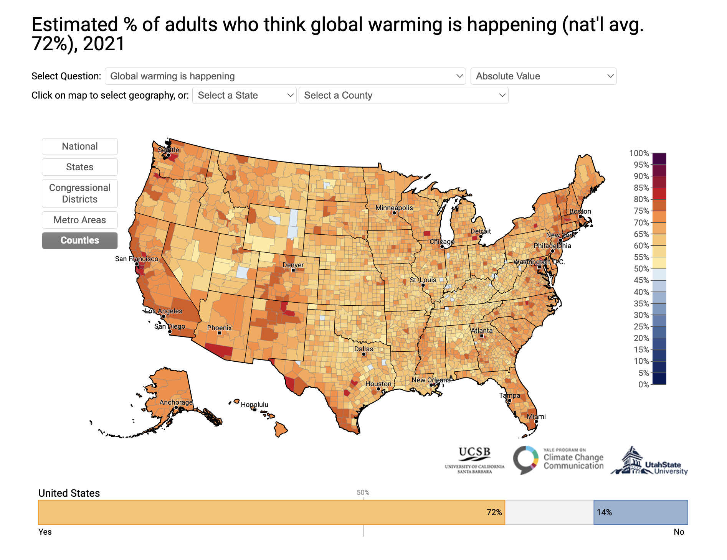
% who think global warming is happening (72%)

Slide 5
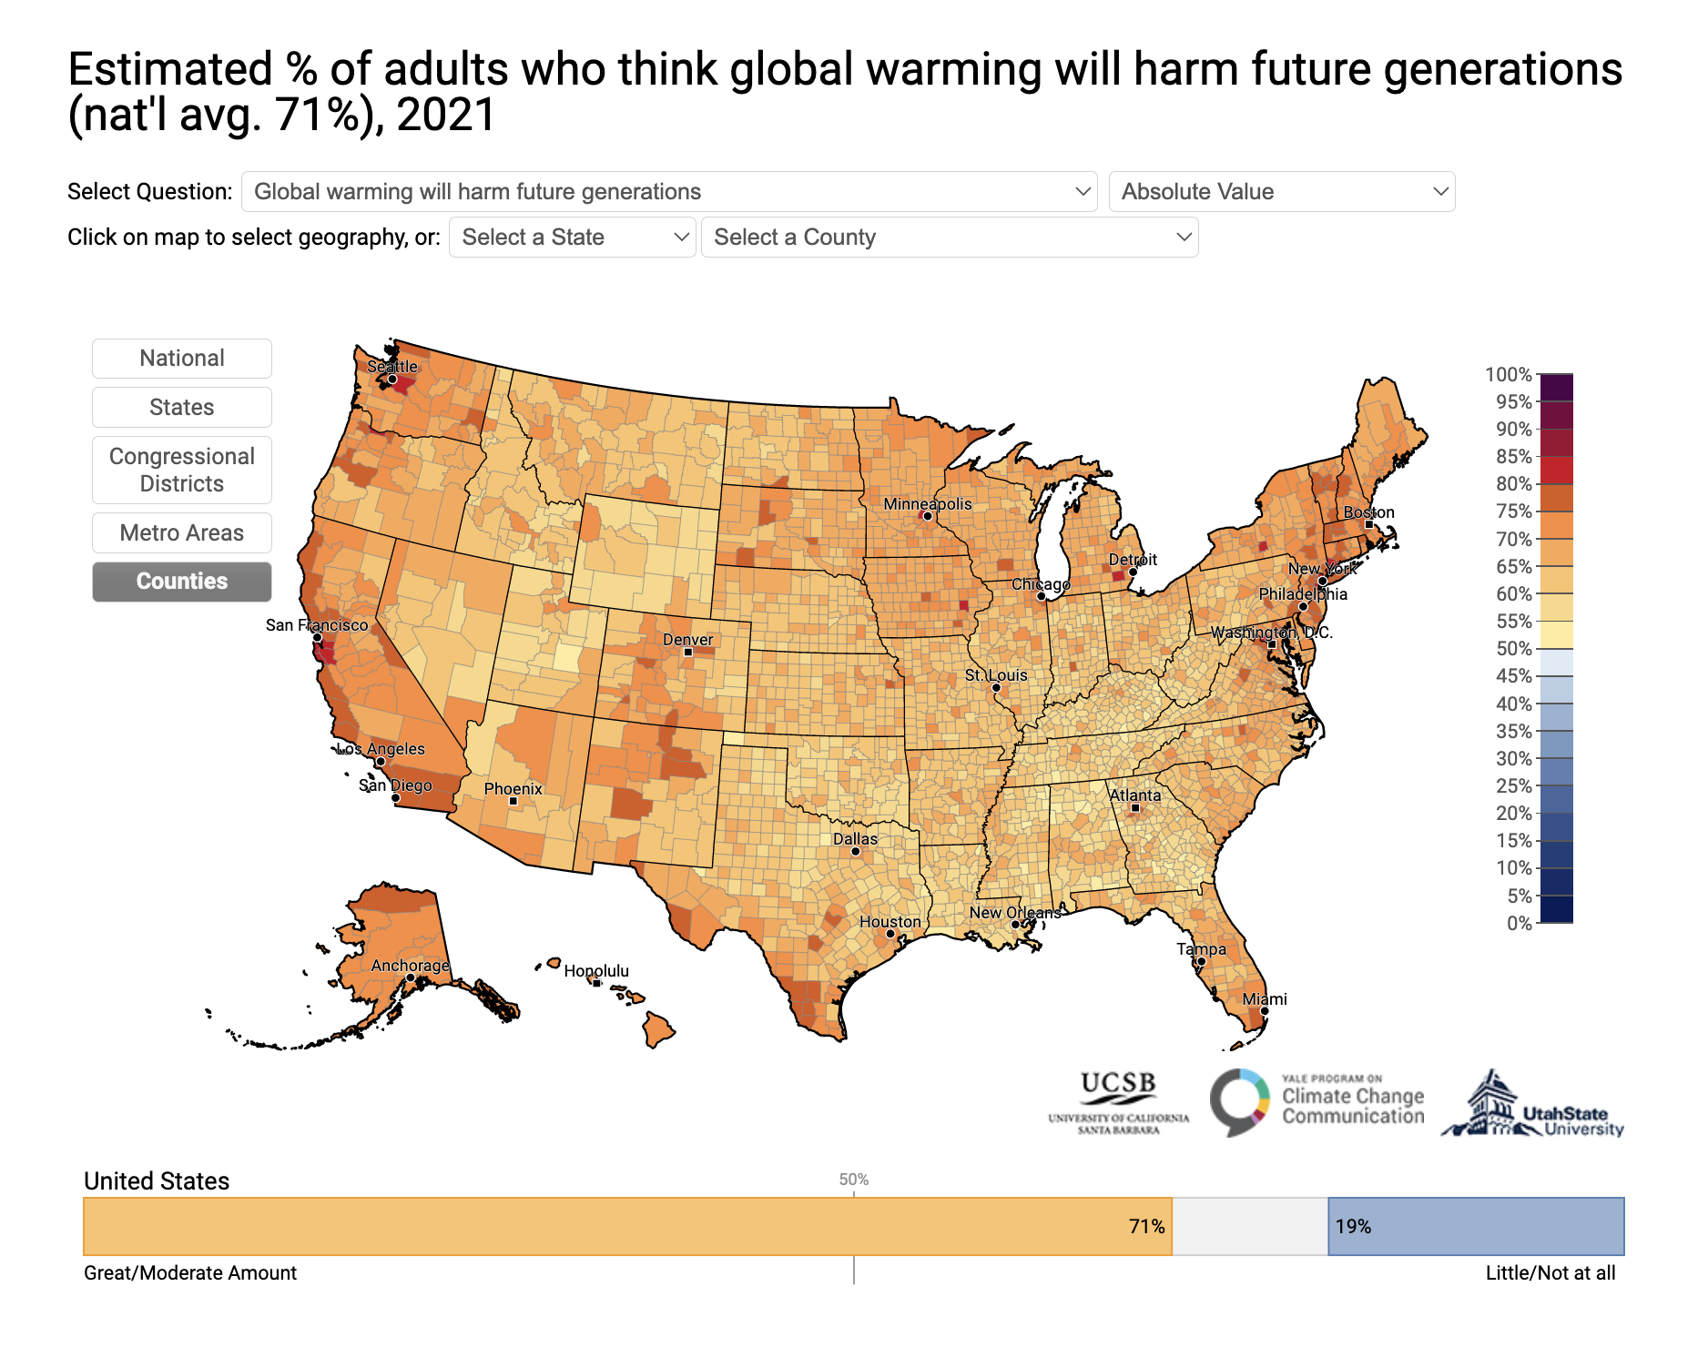
% who think global warming will harm future generations (71%)

Slide 6
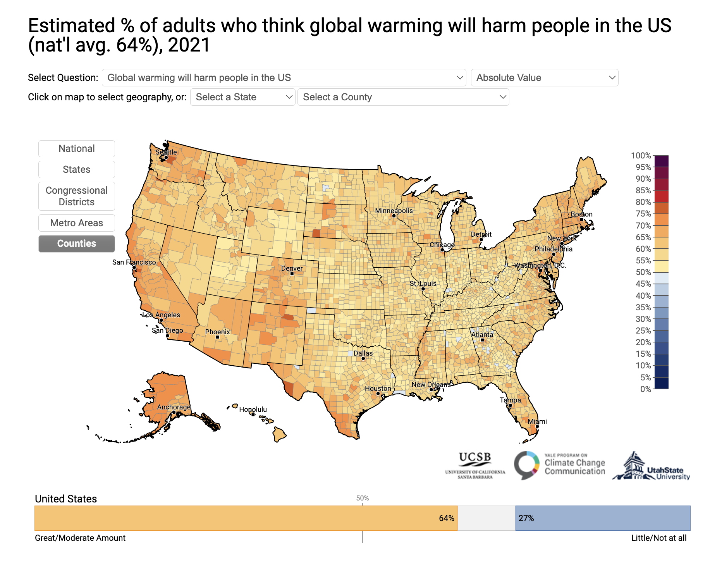
% who think global warming will harm people in the US (64%)

Slide 7
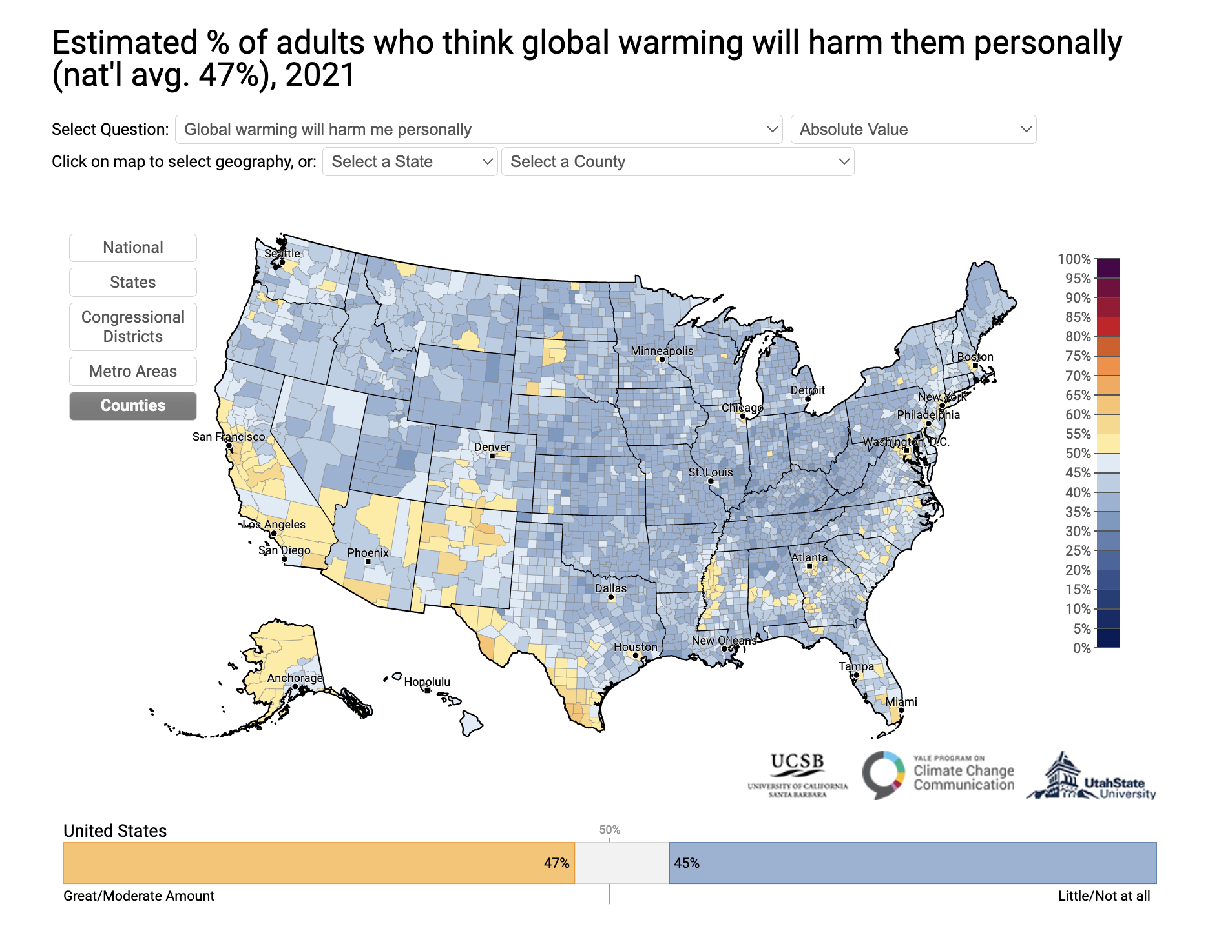
% who think global warming will harm them personally (47%)

Slide 8
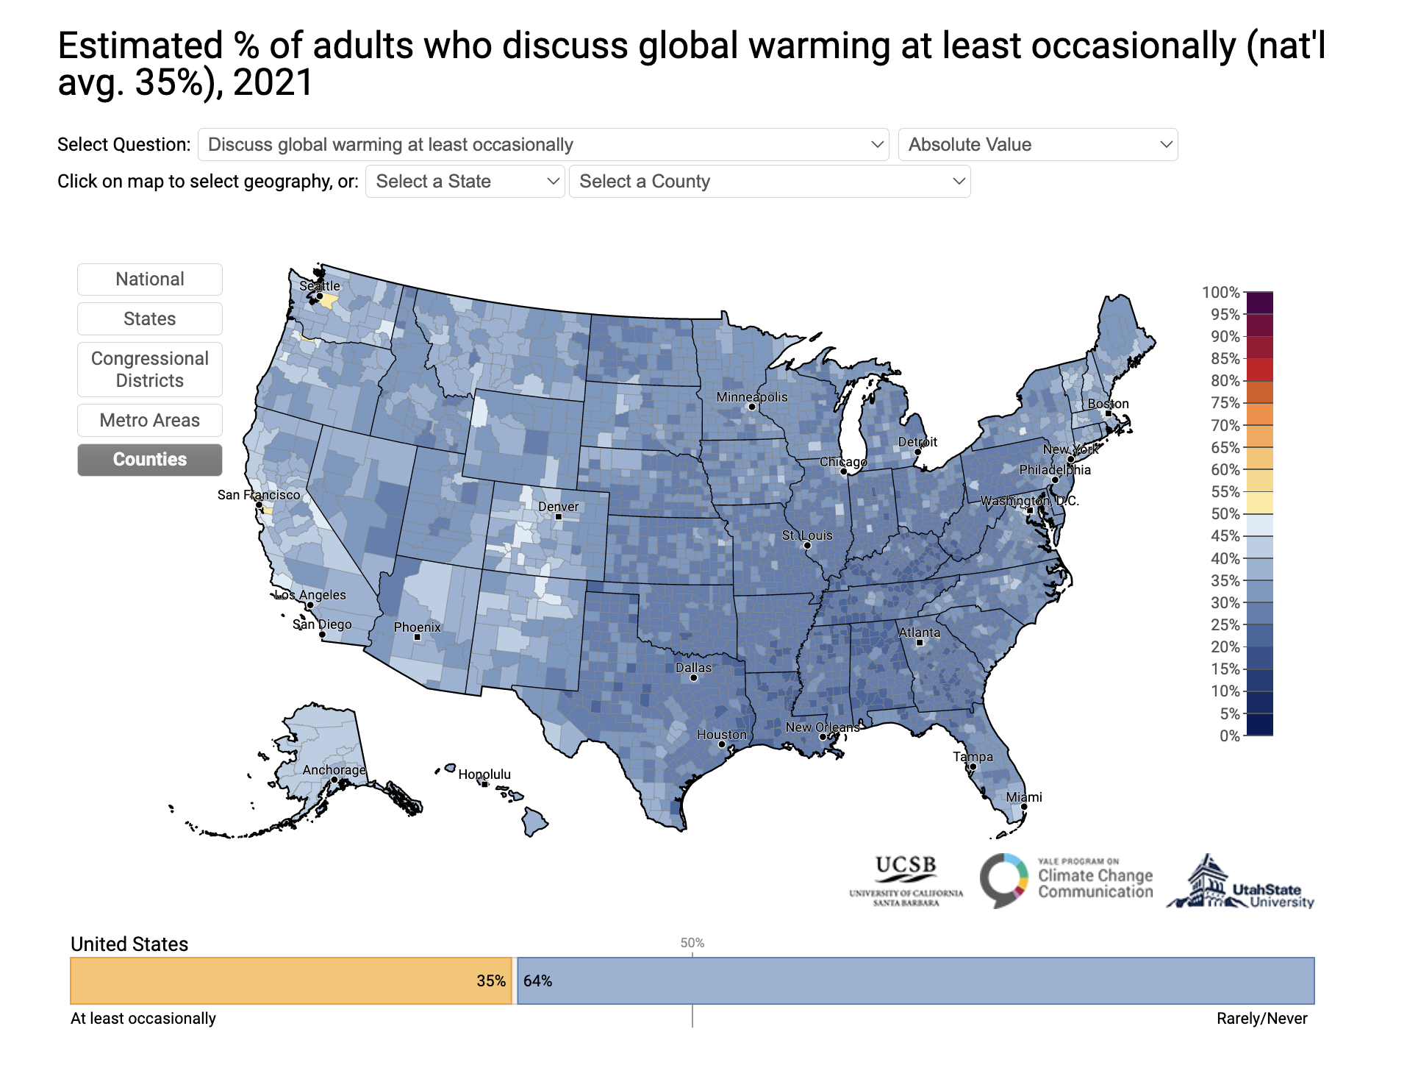
% who discuss global warming at least occasionally (35%)

Slide 9
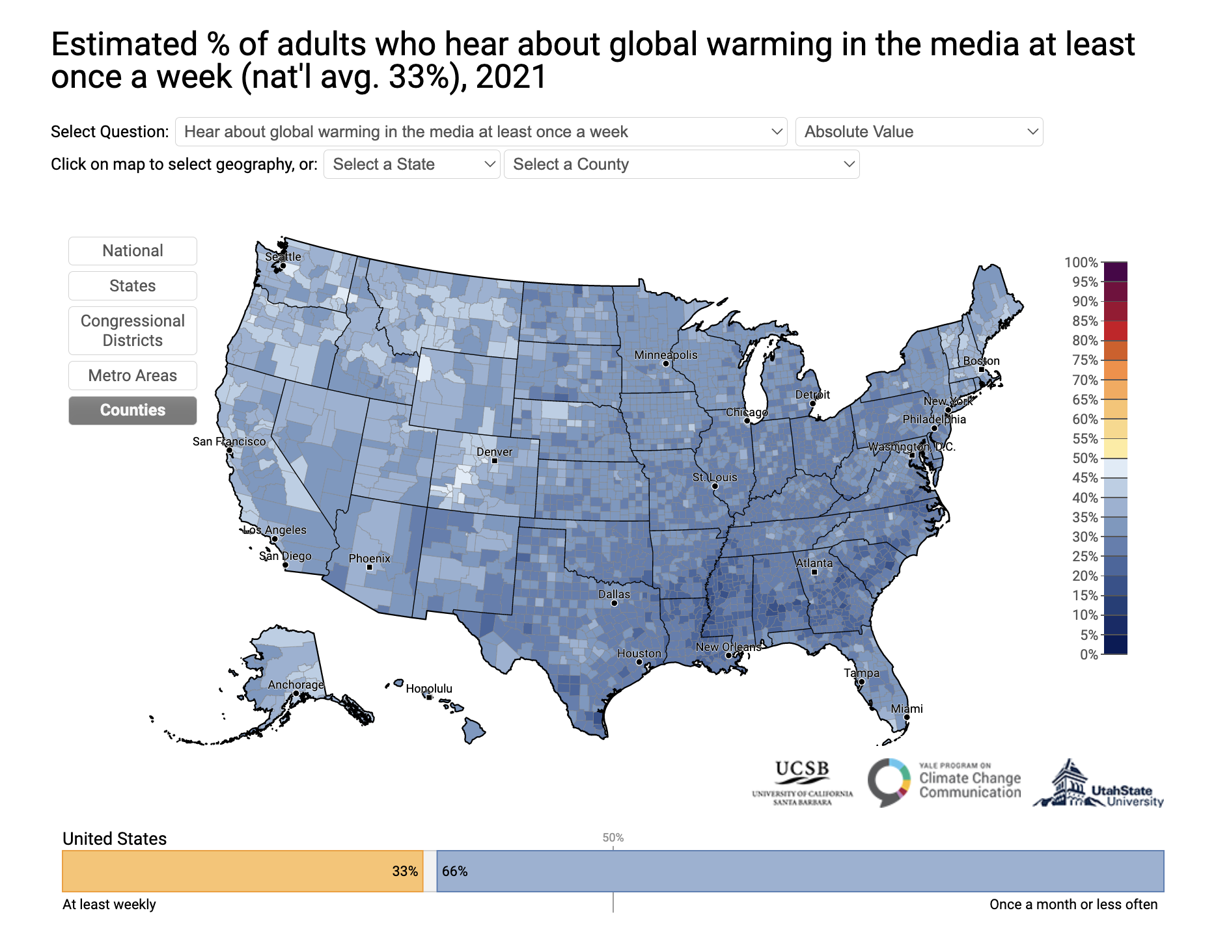
% who hear about global warming at least once a week (33%)

Slide 10
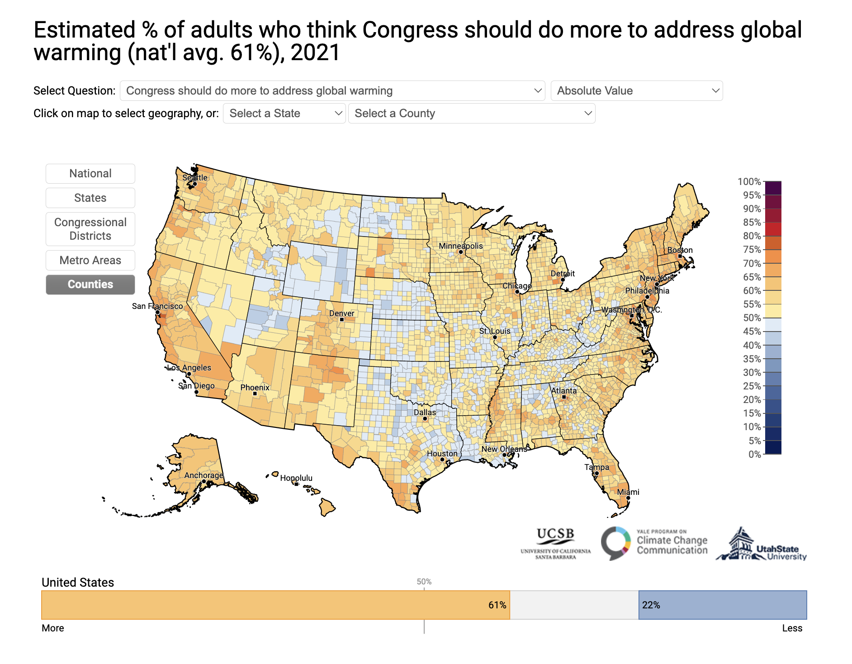
% who think Congress should do more to address global warming (61%)

Slide 11
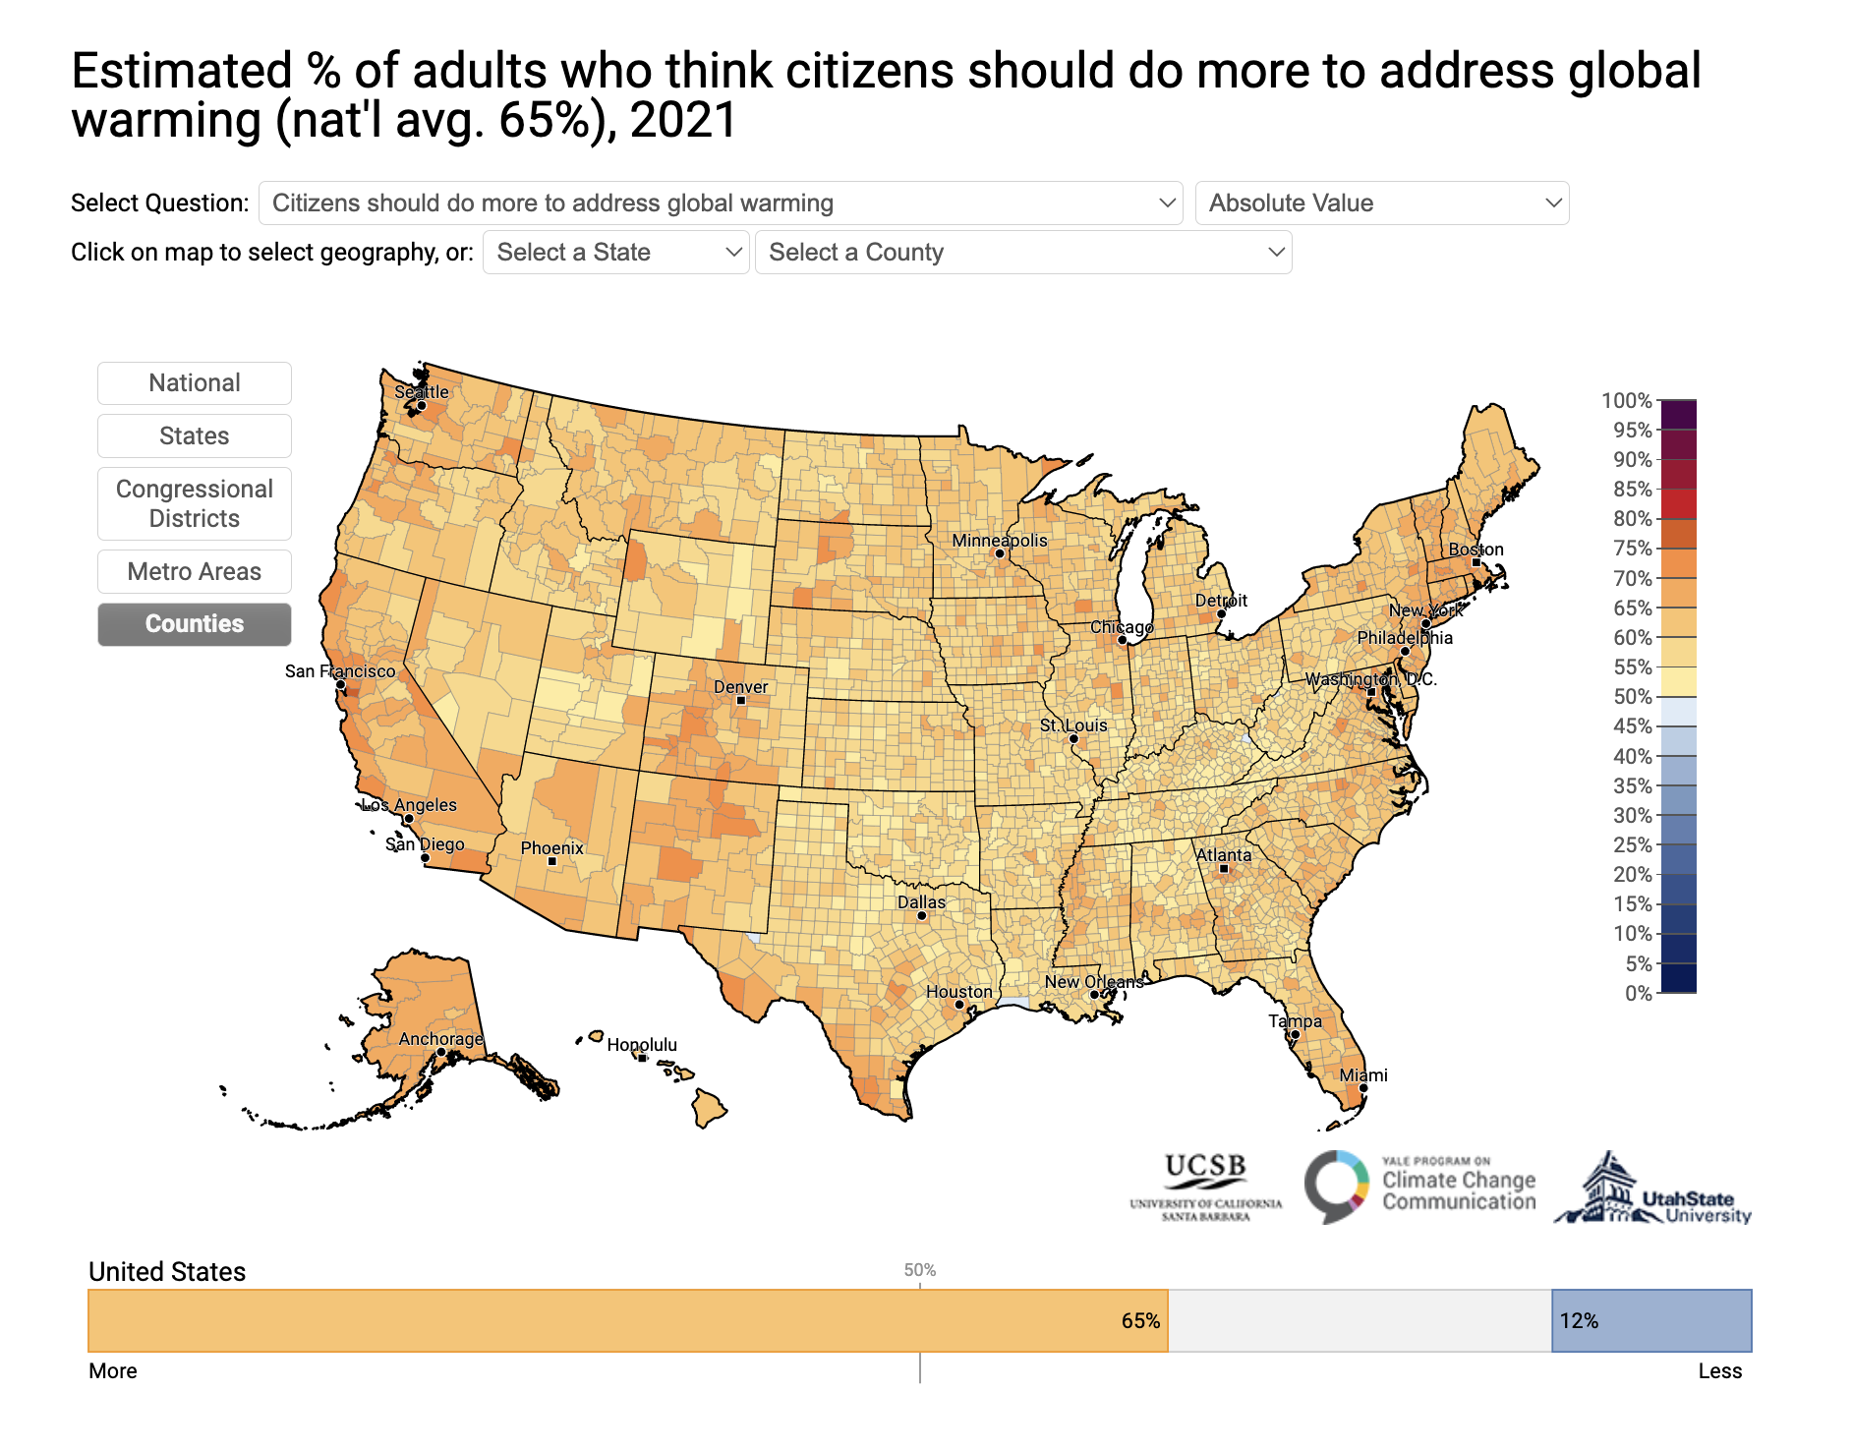
% who think citizens should do more to address global warming (65%)

Slide 12
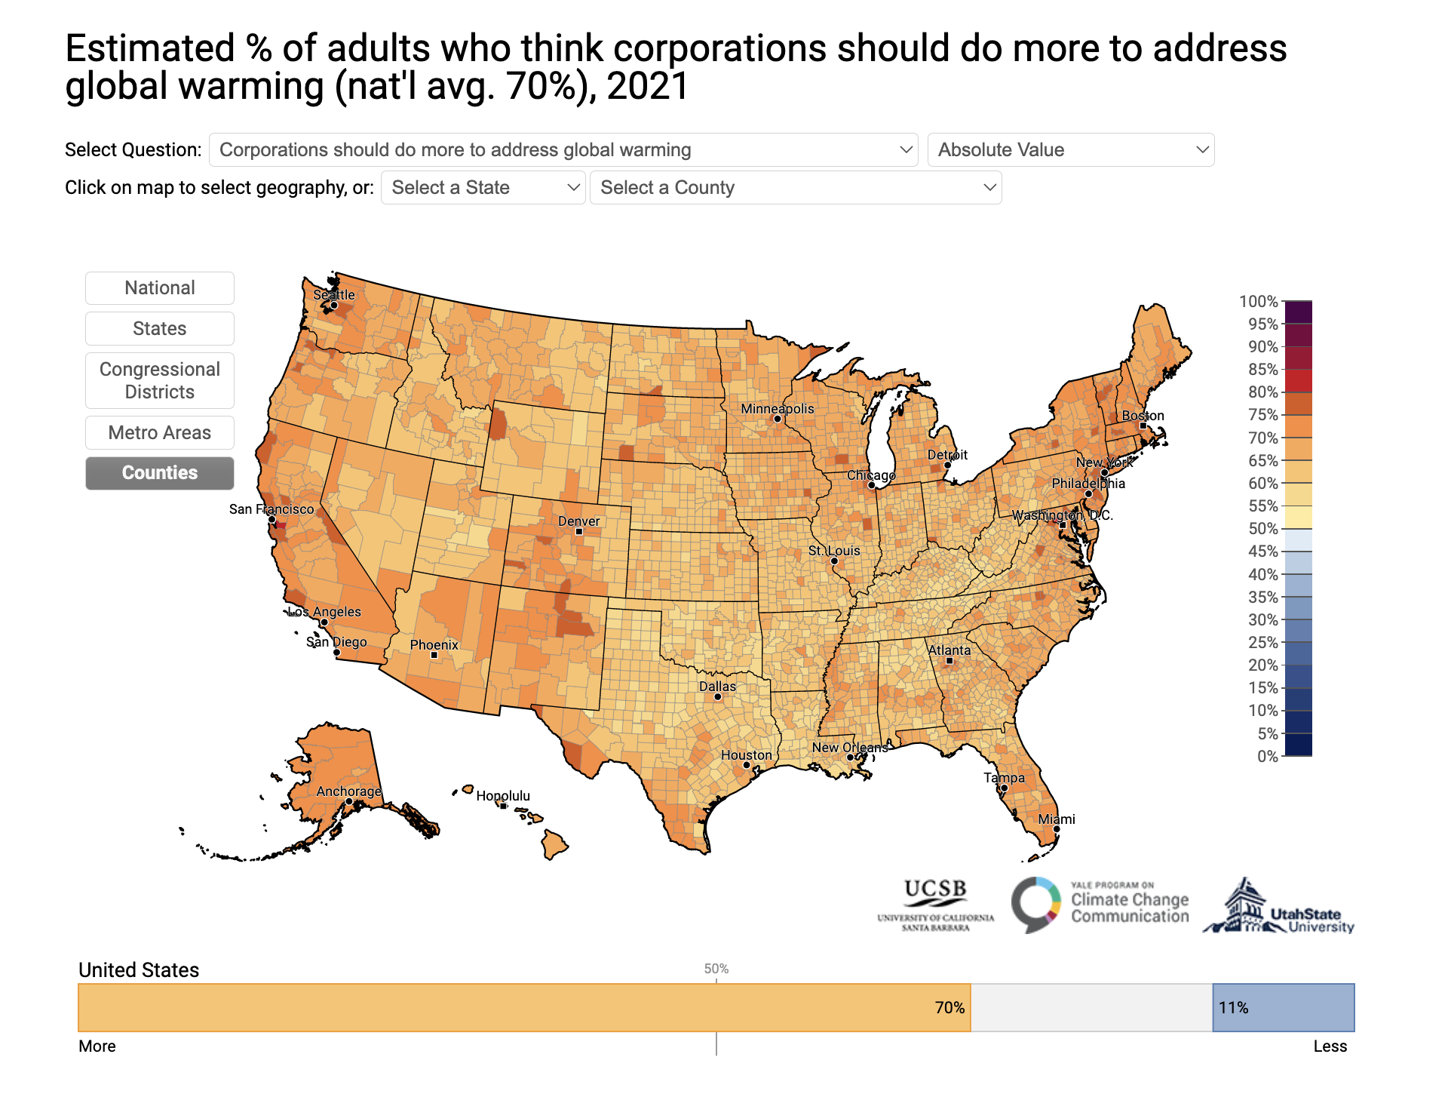
% who think corporations should do more to address global warming (70%)

Slide 13
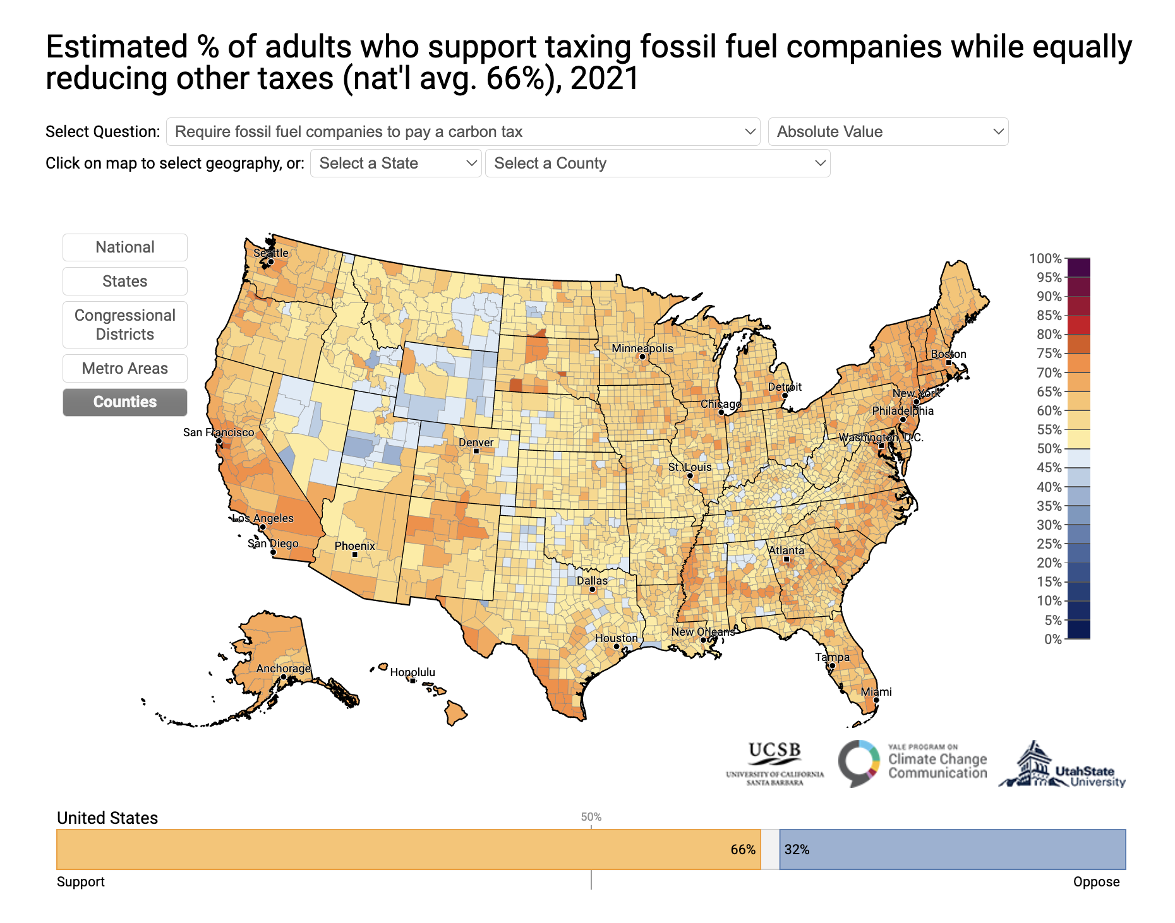
% who support taxing fossil fuel companies while equally reducing other taxes (66%)

Slide 14
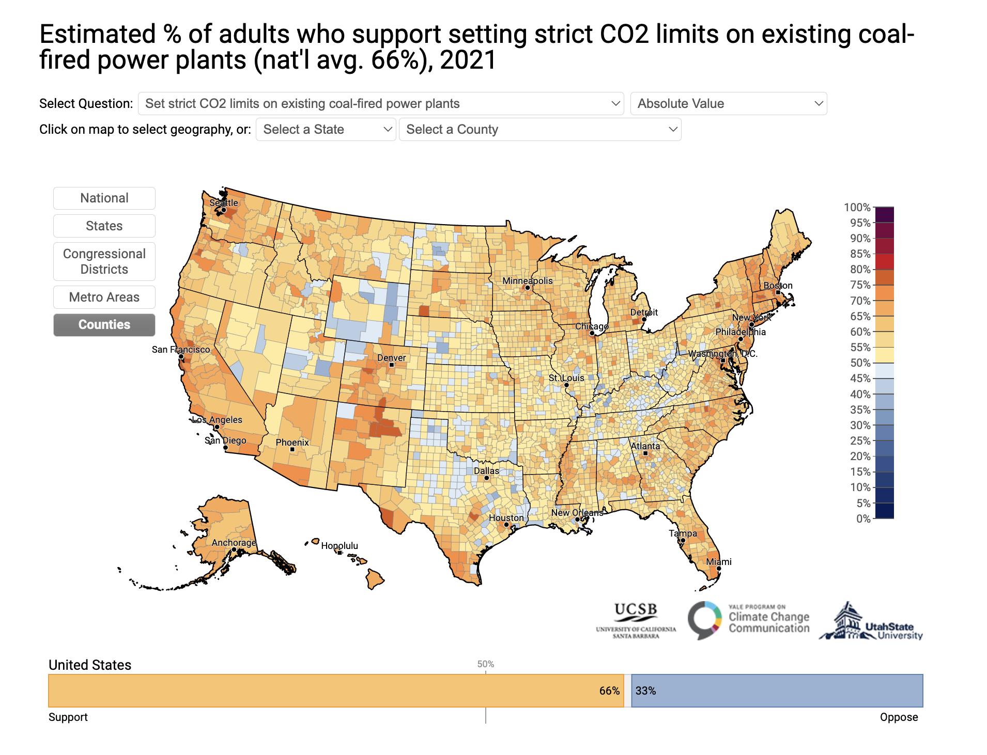
% who support setting strict CO2 limits on existing coal-fired power plants (66%)

Slide 15
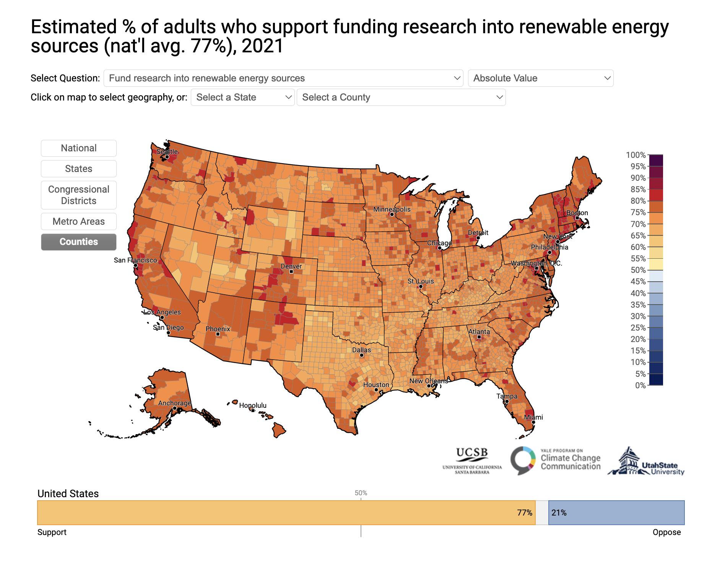
% who support funding research into renewable energy sources (77%)

Slide 16
Key Takeaways
US residents still underestimate the risks of climate change to their families and communities
People also underestimate how pervasive the desire for more action is across sectors and actors
There is widespread support for policies that reduce carbon emissions and improve sustainability
Source: https://climatecommunication.yale.edu/visualizations-data/ycom-us/

